Slide 1

Nested Loops
Chris Piech
CS106A, Stanford University

Slide 2
Boolean Variables
// Store expressions that evaluate to true/false
boolean x = 1 < 2; // true
boolean y = 5.0 == 4.0; // false

Slide 3
Boolean Variables
// Store expressions that evaluate to true/false
boolean x = 1 < 2; // true
boolean y = 5.0 == 4.0; // false
// Directly set to true/false
boolean isFamilyVisiting = true;
boolean isRaining = false;

Slide 4
Boolean Variables
// Store expressions that evaluate to true/false
boolean x = 1 < 2; // true
boolean y = 5.0 == 4.0; // false
// Directly set to true/false
boolean isFamilyVisiting = true;
boolean isRaining = false;
// Ask the user a true/false (yes/no) question
boolean playAgain = readBoolean("Play again?”, "y", "n");
if (playAgain) {
...
Notes:
Note: does not store the whole expression – just the value.
Note – we don’t need to check if it’s true

Slide 5
*know your logical precedence

Slide 6
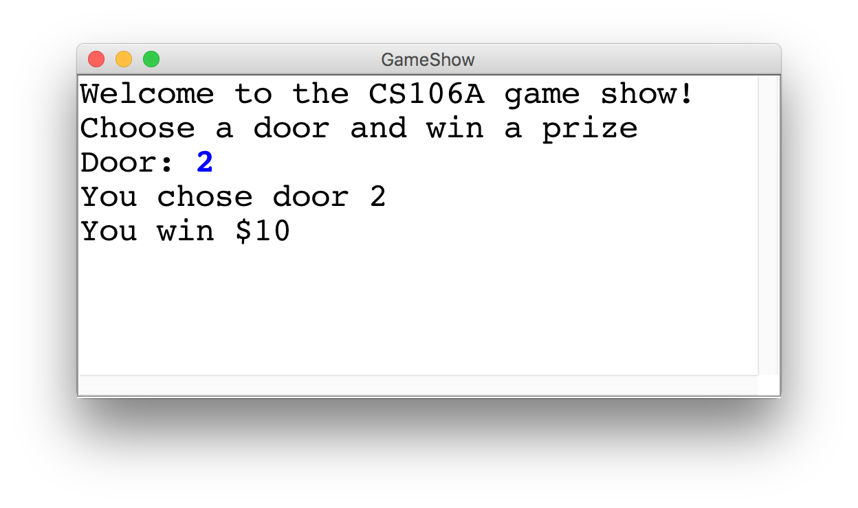
Game Show

Slide 7
Choose a Door
int door = readInt("Door: ");
// while the input is invalid
while(door < 1 || door > 3) {
// tell the user the input was invalid
println("Invalid door!");
// ask for a new input
door = readInt("Door: ");
}
|| or
&& and

Slide 8
The Door Logic
int prize = 4;
if(door == 1) {
prize = 2 + 9 / 10 * 100;
} else if(door == 2) {
boolean locked = prize % 2 != 0;
if(!locked) {
prize += 6;
}
} else if(door == 3) {
prize++;
}

Slide 9
The Door Logic
int prize = 4;
if(door == 1) {
prize = 2 + 9 / 10 * 100;
} else if(door == 2) {
boolean locked = prize % 2 != 0;
if(!locked) {
prize += 6;
}
} else if(door == 3) {
prize++;
}

Slide 10
The Door Logic
int prize = 4;
if(door == 1) {
prize = 2 + 9 / 10 * 100;
} else if(door == 2) {
boolean locked = prize % 2 != 0;
if(!locked) {
prize += 6;
}
} else if(door == 3) {
prize++;
}

Slide 11
The Door Logic
int prize = 4;
if(door == 1) {
prize = 2 + 9 / 10 * 100;
} else if(door == 2) {
boolean locked = prize % 2 != 0;
if(!locked) {
prize += 6;
}
} else if(door == 3) {
prize++;
}

Slide 12
The Door Logic
int prize = 4;
if(door == 1) {
prize = 2 + 9 / 10 * 100;
} else if(door == 2) {
boolean locked = prize % 2 != 0;
if(!locked) {
prize += 6;
}
} else if(door == 3) {
prize++;
}

Slide 13
How would you println “Stanford rocks socks”
100 times

Slide 14
For Loop Redux
public void run() {
for(int i = 0; i < 100; i++) {
println(“Stanford rocks socks!”);
}
}

Slide 15
For Loop Redux
Enters the loop if this condition passes
This line is run each time the code gets to the end of the ‘body’
This line is run once, just before the for loop starts
for(int i = 0; i < 100; i++) {
println(“Stanford rocks socks!”);
}

Slide 16

For Loop Redux
for(int i = 0; i < 3; i++) {
println(“Stanford rocks socks!”);
}
For Loop Redux

Slide 17
For Loop Redux
for(int i = 0; i < 3; i++) {
println(“Stanford rocks socks!”);
}
For Loop Redux

Slide 18
For Loop Redux
i
0
for(int i = 0; i < 3; i++) {
println(“Stanford rocks socks!”);
}
For Loop Redux

Slide 19
For Loop Redux
i
0
for(int i = 0; i < 3; i++) {
println(“Stanford rocks socks!”);
}
For Loop Redux

Slide 20
For Loop Redux
i
0
for(int i = 0; i < 3; i++) {
println(“Stanford rocks socks!”);
}
For Loop Redux
Stanford rocks socks

Slide 21
For Loop Redux
i
1
for(int i = 0; i < 3; i++) {
println(“Stanford rocks socks!”);
}
For Loop Redux
Stanford rocks socks

Slide 22
For Loop Redux
i
1
for(int i = 0; i < 3; i++) {
println(“Stanford rocks socks!”);
}
For Loop Redux
Stanford rocks socks

Slide 23
For Loop Redux
i
1
for(int i = 0; i < 3; i++) {
println(“Stanford rocks socks!”);
}
For Loop Redux
Stanford rocks socks
Stanford rocks socks

Slide 24
For Loop Redux
i
2
for(int i = 0; i < 3; i++) {
println(“Stanford rocks socks!”);
}
For Loop Redux
Stanford rocks socks
Stanford rocks socks

Slide 25
For Loop Redux
i
2
for(int i = 0; i < 3; i++) {
println(“Stanford rocks socks!”);
}
For Loop Redux
Stanford rocks socks
Stanford rocks socks

Slide 26
For Loop Redux
i
2
for(int i = 0; i < 3; i++) {
println(“Stanford rocks socks!”);
}
For Loop Redux
Stanford rocks socks
Stanford rocks socks
Stanford rocks socks

Slide 27
For Loop Redux
i
3
for(int i = 0; i < 3; i++) {
println(“Stanford rocks socks!”);
}
For Loop Redux
Stanford rocks socks
Stanford rocks socks
Stanford rocks socks

Slide 28
For Loop Redux
i
3
for(int i = 0; i < 3; i++) {
println(“Stanford rocks socks!”);
}
For Loop Redux
Stanford rocks socks
Stanford rocks socks
Stanford rocks socks

Slide 29
For Loop Redux
for(int i = 0; i < 3; i++) {
println(“Stanford rocks socks!”);
}
For Loop Redux
Stanford rocks socks
Stanford rocks socks
Stanford rocks socks

Slide 30
For Loop Redux
for(int i = 0; i < 3; i++) {
println(“Stanford rocks socks!”);
}
For Loop Redux
Stanford rocks socks
Stanford rocks socks
Stanford rocks socks

Slide 31
You can use the for loop variable

Slide 32
How would you println the first 100 even numbers?

Slide 33
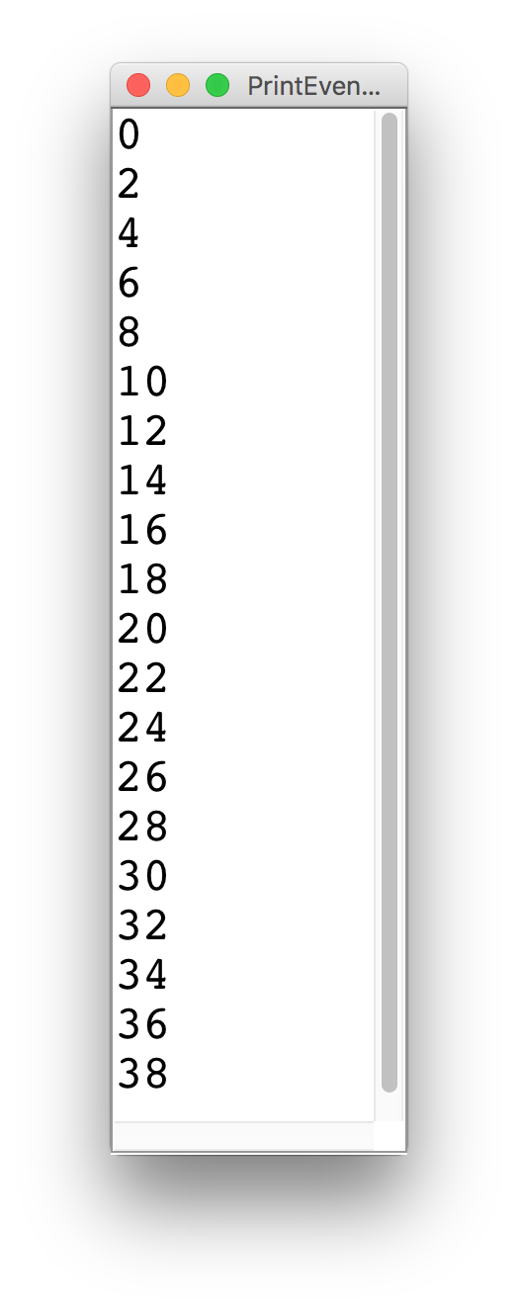
Printing Even Numbers

Slide 34
Printing Even Numbers
for(int i = 0; i < NUM_NUMS; i++) {
println(i * 2);
}

Slide 35
Printing Even Numbers
for(int i = 0; i < 3; i++) {
println(i * 2);
}
For Loop Redux

Slide 36
Printing Even Numbers
for(int i = 0; i < 3; i++) {
println(i * 2);
}
For Loop Redux

Slide 37
Printing Even Numbers
i
0
for(int i = 0; i < 3; i++) {
println(i * 2);
}
For Loop Redux

Slide 38
Printing Even Numbers
i
0
for(int i = 0; i < 3; i++) {
println(i * 2);
}
For Loop Redux

Slide 39
Printing Even Numbers
i
0
for(int i = 0; i < 3; i++) {
println(i * 2);
}
For Loop Redux
0

Slide 40
Printing Even Numbers
i
1
for(int i = 0; i < 3; i++) {
println(i * 2);
}
For Loop Redux
0

Slide 41
Printing Even Numbers
i
1
for(int i = 0; i < 3; i++) {
println(i * 2);
}
For Loop Redux
0

Slide 42
Printing Even Numbers
i
1
for(int i = 0; i < 3; i++) {
println(i * 2);
}
For Loop Redux
0
2

Slide 43
Printing Even Numbers
i
2
for(int i = 0; i < 3; i++) {
println(i * 2);
}
For Loop Redux
0
2

Slide 44
Printing Even Numbers
i
2
for(int i = 0; i < 3; i++) {
println(i * 2);
}
For Loop Redux
0
2

Slide 45
Printing Even Numbers
i
2
for(int i = 0; i < 3; i++) {
println(i * 2);
}
For Loop Redux
0
2
4

Slide 46
Printing Even Numbers
i
3
for(int i = 0; i < 3; i++) {
println(i * 2);
}
For Loop Redux
0
2
4

Slide 47
Printing Even Numbers
i
3
for(int i = 0; i < 3; i++) {
println(i * 2);
}
For Loop Redux
0
2
4

Slide 48
Printing Even Numbers
i
3
for(int i = 0; i < 3; i++) {
println(i * 2);
}
For Loop Redux
0
2
4

Slide 49
Printing Even Numbers
for(int i = 0; i < 3; i++) {
println(i * 2);
}
For Loop Redux
0
2
4

Slide 50

By Chris

Slide 51
Once upon a time…

Slide 52

X was looking for love!
int x = 5;
if(lookingForLove()) {
int y = 5;
}
println(x + y);
5
x

Slide 53
X was looking for love!
int x = 5;
if(lookingForLove()) {
int y = 5;
}
println(x + y);
5
x

Slide 54
X was looking for love!
x was definitely
looking for love
int x = 5;
if(lookingForLove()) {
int y = 5;
}
println(x + y);
5
x

Slide 55
And met y
int x = 5;
if(lookingForLove()) {
int y = 5;
}
println(x + y);
5
5
x
y

Slide 56
And met y
int x = 5;
if(lookingForLove()) {
int y = 5;
}
println(x + y);
5
5
Hi, I’m y
x
y

Slide 57
“Wow!”

Slide 58
And met y
int x = 5;
if(lookingForLove()) {
int y = 5;
}
println(x + y);
Wow
5
5
x
y

Slide 59
And met y
int x = 5;
if(lookingForLove()) {
int y = 5;
}
println(x + y);
5
5
We have so much in common
x
y

Slide 60
And met y
int x = 5;
if(lookingForLove()) {
int y = 5;
}
println(x + y);
5
5
We both have value 5!
x
y

Slide 61
And met y
int x = 5;
if(lookingForLove()) {
int y = 5;
}
println(x + y);
5
5
Maybe one day we can…
x
y

Slide 62
And met y
int x = 5;
if(lookingForLove()) {
int y = 5;
}
println(x + y);
5
5
println together?
x
y

Slide 63
They got along
int x = 5;
if(lookingForLove()) {
int y = 5;
}
println(x + y);
5
5
x
y

Slide 64
It was a beautiful match…

Slide 65
But then tragedy struck.

Slide 66
Tragedy Struck
int x = 5;
if(lookingForLove()) {
int y = 5;
}
println(x + y);
5
5
x
y

Slide 67
Tragedy Struck
int x = 5;
if(lookingForLove()) {
int y = 5;
}
println(x + y);
5
5
x
y

Slide 68
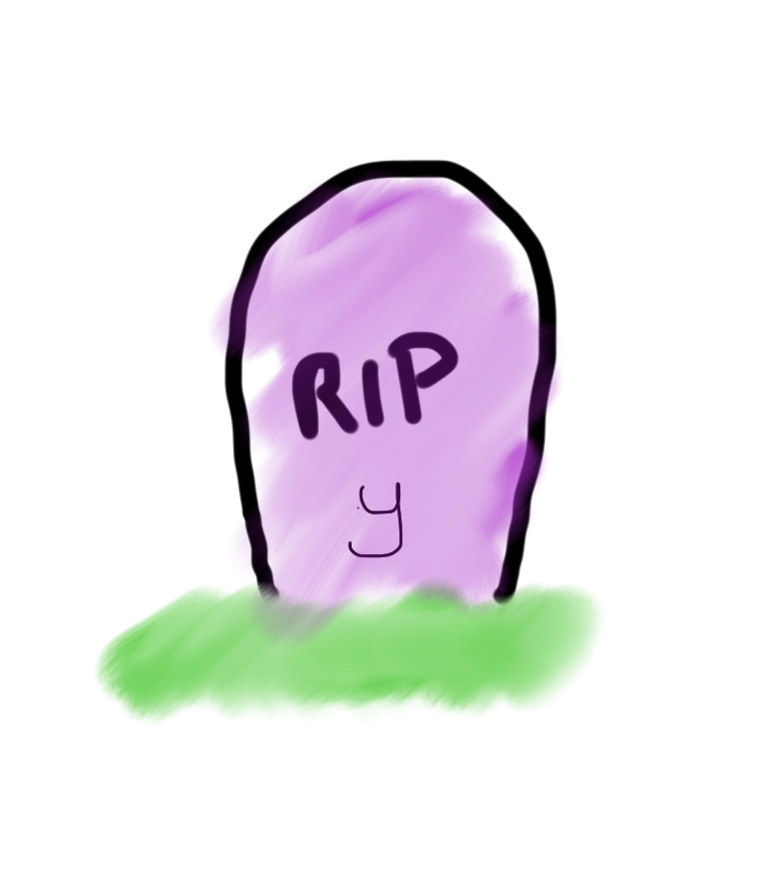
Tragedy Struck
int x = 5;
if(lookingForLove()) {
int y = 5;
}
println(x + y);
5
x

Slide 69
Noooooooooooooooo!

Slide 70
You see…

Slide 71
When a program exits a code block…
int x = 5;
if(lookingForLove()) {
int y = 5;
}
println(x + y);
5
x

Slide 72
All variables declared inside that block..
int x = 5;
if(lookingForLove()) {
int y = 5;
}
println(x + y);
5
x

Slide 73
Get deleted from memory!
int x = 5;
if(lookingForLove()) {
int y = 5;
}
println(x + y);
5
x

Slide 74
Since y was declared in the if-block
int x = 5;
if(lookingForLove()) {
int y = 5;
}
println(x + y);
5
x

Slide 75
It gets deleted from memory here
int x = 5;
if(lookingForLove()) {
int y = 5;
}
println(x + y);
5
x

Slide 76
And doesn’t exist here
int x = 5;
if(lookingForLove()) {
int y = 5;
}
println(x + y);
5
x

Slide 77
And doesn’t exist here
Error. Undefined variable y.
int x = 5;
if(lookingForLove()) {
int y = 5;
}
println(x + y);
5
x

Slide 78
The End

Slide 79
Sad times ☹

Slide 80
Variables have a lifetime (called scope)
public void run(){
double v = 8;
if(condition){
v = 4;
… some code
}
… some other code
}

Slide 81
Variables have a lifetime (called scope)
public void run(){
double v = 8;
if(condition){
v = 4;
… some code
}
… some other code
}

Slide 82
Vars come to existence when declared
public void run(){
double v = 8;
if(condition){
v = 4;
… some code
}
… some other code
}
Comes to life here
8
v

Slide 83
Live until end of their code block
public void run(){
double v = 8;
if(condition){
v = 4;
… some code
}
… some other code
}
This is the inner most
code block in which it was
declared….
4
v

Slide 84
Live until end of their code block
public void run(){
double v = 8;
if(condition){
v = 4;
… some code
}
… some other code
}
Still alive here…
4
v

Slide 85
Live until end of their code block
public void run(){
double v = 8;
if(condition){
v = 4;
… some code
}
… some other code
}
4
v
It dies here (at the end of its code block)

Slide 86

Live until end of their code block
public void run(){
double v = 8;
if(condition){
v = 4;
… some code
}
… some other code
}
It dies here (at the end of its code block)

Slide 88
Example 2
public void run(){
… some code
if(condition){
int w = 4;
… some code
}
… some other code
}
This is the scope of w

Slide 89
Example 2
public void run(){
… some code
if(condition){
int w = 4;
… some code
}
… some other code
}
w comes to life here
w dies here (at the end of its code block)

Slide 90
Chapter 2

Slide 91
The programmer fixed her bug

Slide 92
x was looking for love!
int x = 5;
if(lookingForLove()) {
int y = 5;
println(x + y);
}
5
x

Slide 93
x was looking for love…
x was definitely
looking for love
int x = 5;
if(lookingForLove()) {
int y = 5;
println(x + y);
}
5
x

Slide 94
x met y
int x = 5;
if(lookingForLove()) {
int y = 5;
println(x + y);
}
5
5
x
y

Slide 95
Since they were both “in scope”
int x = 5;
if(lookingForLove()) {
int y = 5;
println(x + y);
}
5
5
x
y

Slide 96
The story had a happy ending!

Slide 97
Scope Formally
The scope of a variable refers to the section of code where a variable can be accessed.
Scope starts where the variable is declared.
Scope ends at the termination of the inner-most code block in which the variable was defined.
A code block is a chunk of code between { } brackets

Slide 98
Back to our regularly scheduled program…

Slide 99
Types of Programs
Program
Karel Program
Console Program
Graphics Program

Slide 100
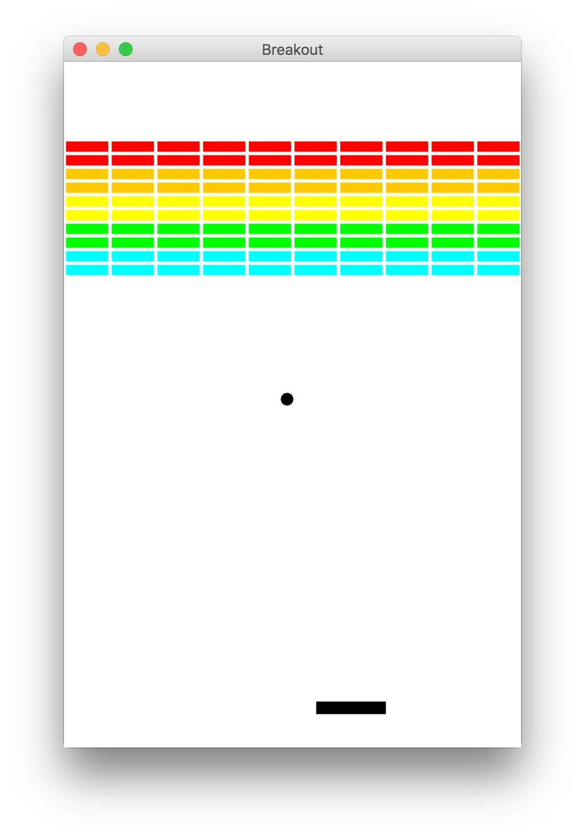
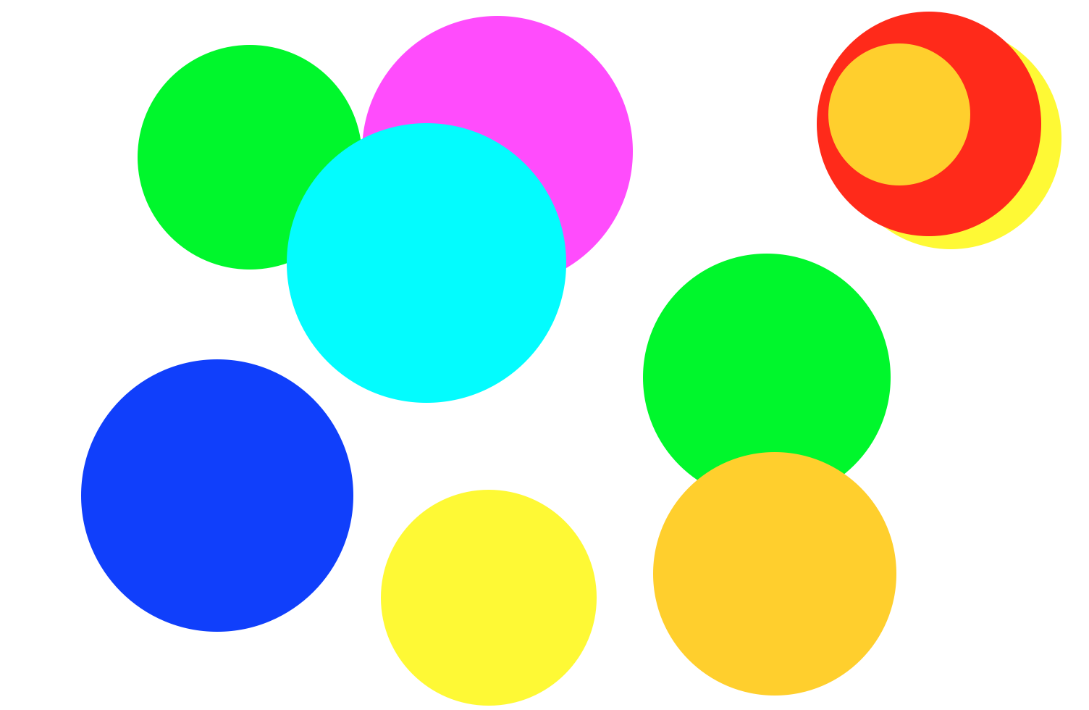
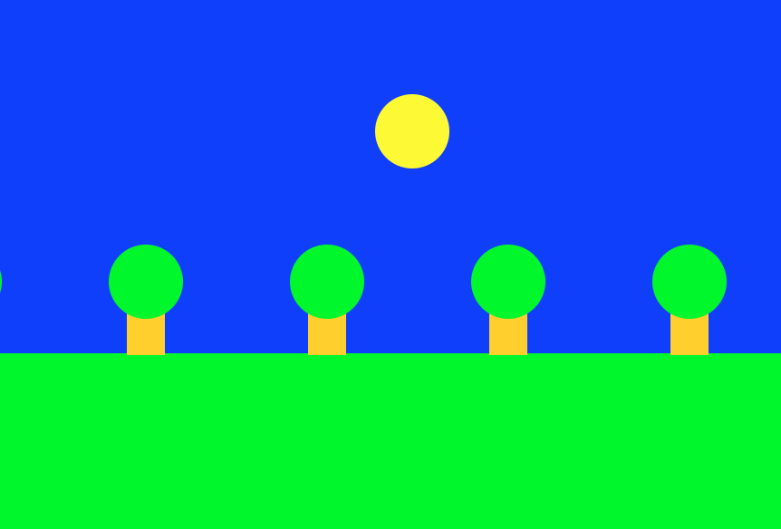
Graphics Programs

Slide 101
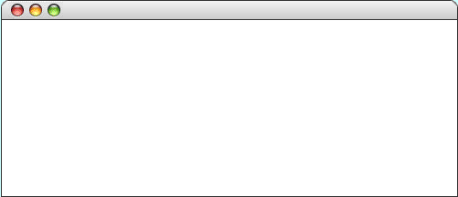
GRect
GRect is a variable type that stores a rectangle.
As an example, the following run method displays a blue square
public void run() {
GRect rect = new GRect(200, 200);
rect.setFilled(true);
rect.setColor(Color.BLUE);
add(rect, 50, 50);
}
Hello Rect
rect

Slide 102
GRect
GRect is a variable type that stores a rectangle.
As an example, the following run method displays a blue square
public void run() {
GRect rect = new GRect(200, 200);
rect.setFilled(true);
rect.setColor(Color.BLUE);
add(rect, 50, 50);
}
Hello Rect
rect

Slide 103
GRect
GRect is a variable type that stores a rectangle.
As an example, the following run method displays a blue square
public void run() {
GRect rect = new GRect(200, 200);
rect.setFilled(true);
rect.setColor(Color.BLUE);
add(rect, 50, 50);
}
Hello Rect
rect

Slide 104
GRect
GRect is a variable type that stores a rectangle.
As an example, the following run method displays a blue square
public void run() {
GRect rect = new GRect(200, 200);
rect.setFilled(true);
rect.setColor(Color.BLUE);
add(rect, 50, 50);
}
Hello Rect
rect

Slide 105
GRect
GRect is a variable type that stores a rectangle.
As an example, the following run method displays a blue square
public void run() {
GRect rect = new GRect(200, 200);
rect.setFilled(true);
rect.setColor(Color.BLUE);
add(rect, 50, 50);
}
Hello Rect
rect

Slide 106
Graphics Coordinates
0,0
40,20
120,40
getHeight();
40,120
getWidth();

Slide 107
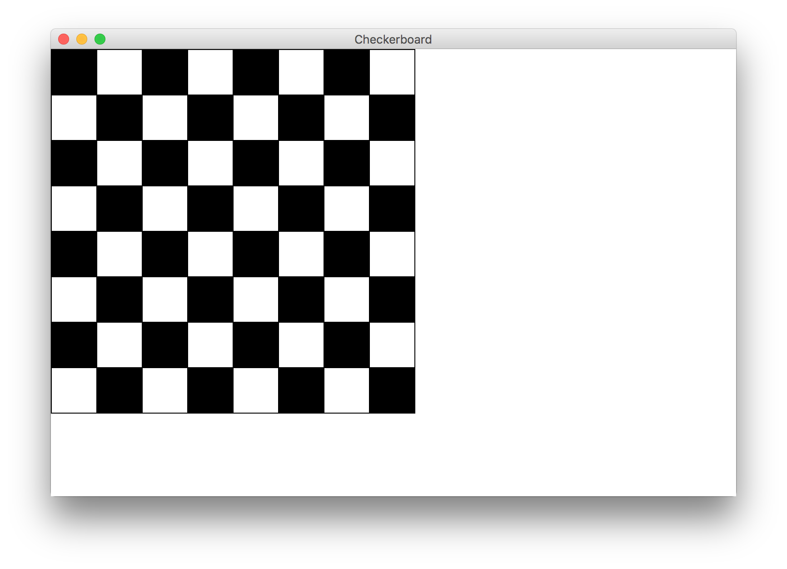
Goal

Slide 108
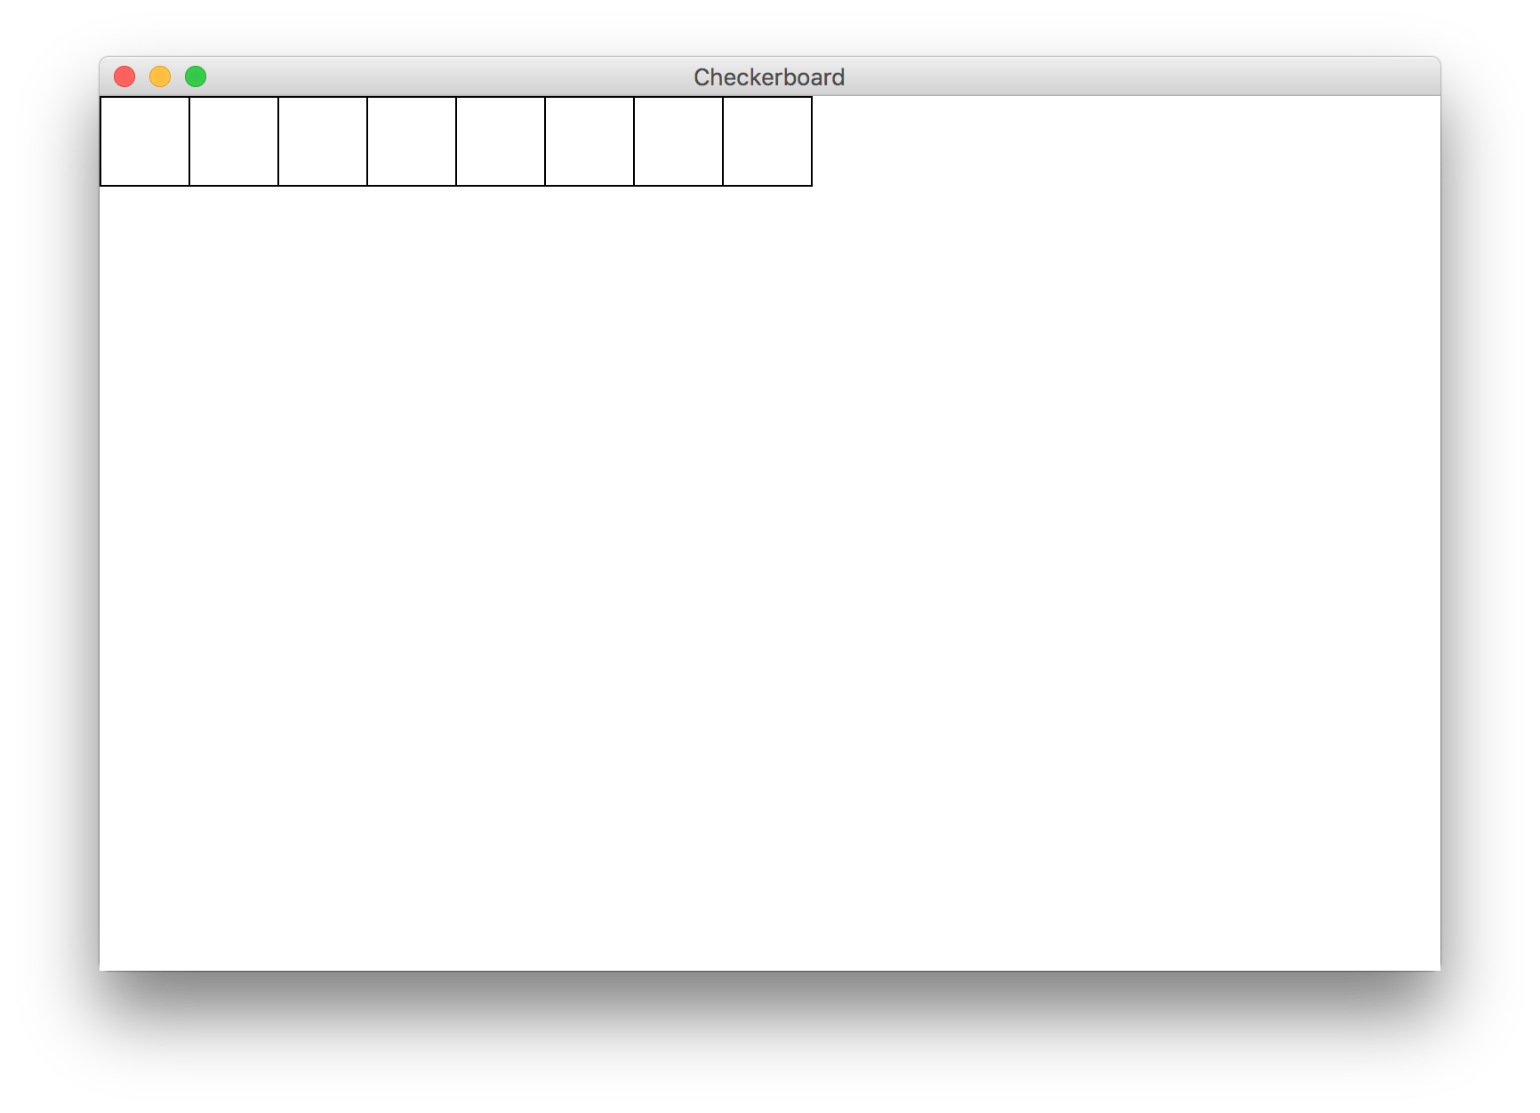
Milestone 1

Slide 109
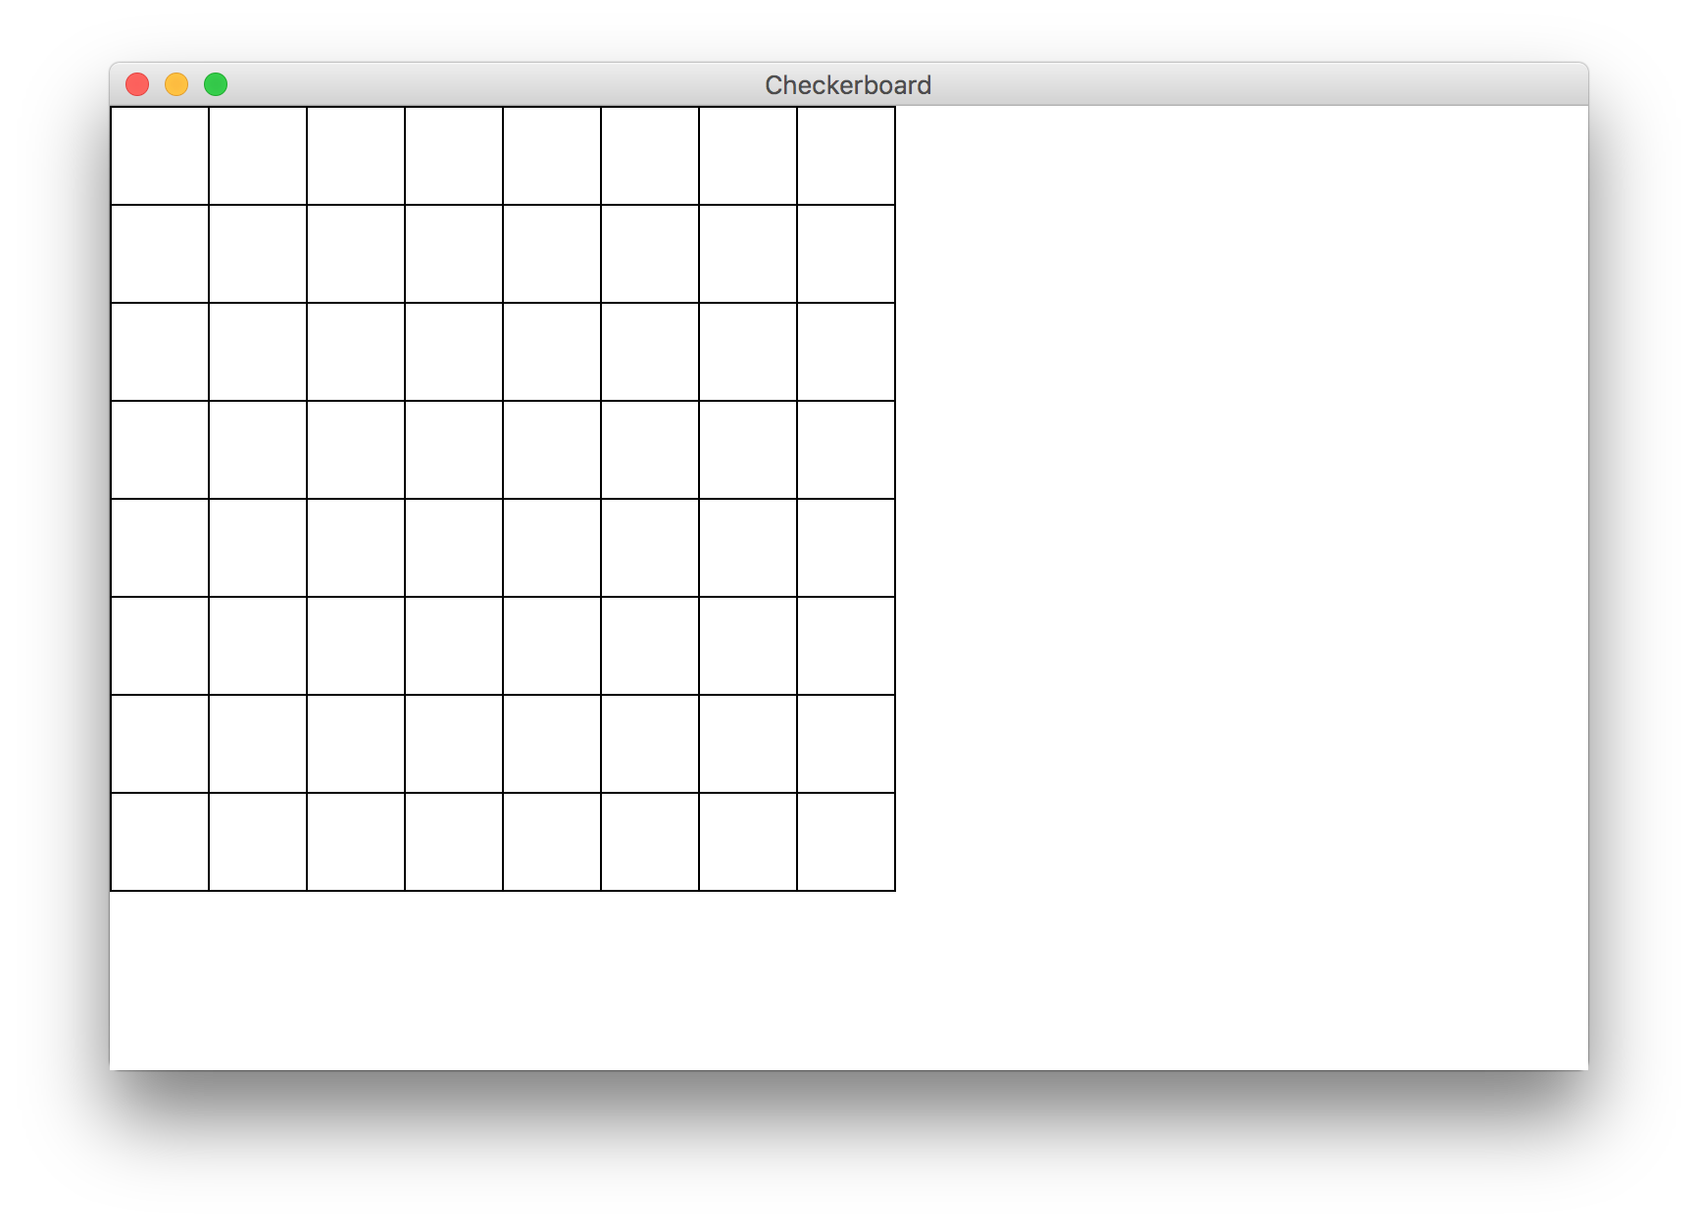
Milestone 2

Slide 110
Milestone 3

